Slide 1
Alert Builder
IN721 2017
Design and Development for Mobile Devices
Session 7.1
Notes:
Today is In-Class Exploration Day!

Slide 2
A Better Looking Alert Dialog
Instead of defining and inflating your own XML layout, you can use AlertDialog.Builder.
Notes:
As mentioned before, my pizza confirm dialog with the two buttons looked pretty crummy.
Because this kind of dialog is so common, Android actually provides a helper class for them – AlertDialog.Builder
You can use this class instead of defining and inflating your own XML layout.
Instead you get a standard layout with an icon, some text and two nicely spaced buttons.

Slide 3
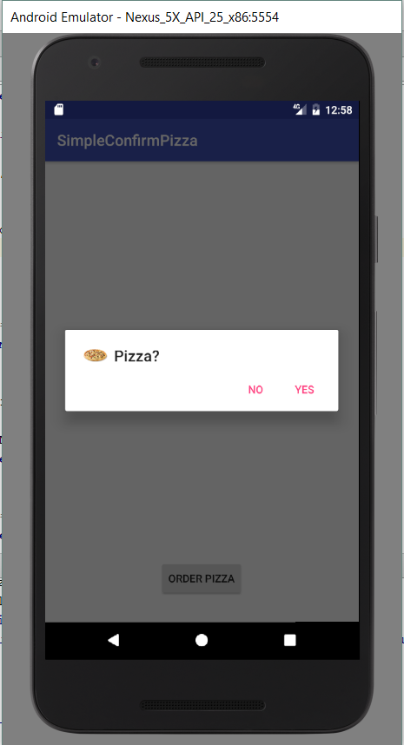
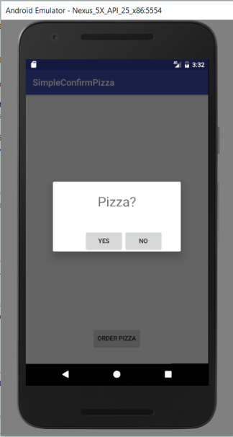
A Better Looking Alert Dialog
Notes:
It looks like this...
Compared to the old one
The button order, with negative first, is part of the new Android look, and you just have to live with it unless you want to make a customised AlertDialog.Builder (i.e. Descend a child from it) and do some code magic.
More typically, these buttons are labelled Cancel and Ok, and the default (Ok) is on the right.

Slide 4
A Better Looking Alert Dialogue
Code goes in the Fragment’s onCreateDialog event handler.
In the onCreateDialog, use a Builder to customise and create the dialog window.
Notes:
Code goes in onCreateDialog, not onCreateView.
When using AlertDialog.Builder, you set up the whole window, not just the controls in the Fragment layout, which sit inside that window.
The “builder” is a common pattern in Android. There are lots of classes whose sole purpose is to help you create instances of other complex objects and get the properties of those objects correctly initialised.
You make a builder instance, use its methods to customise the dialog and then use it to create the Dialog. That’s what you return from onCreateDialog.
Today, you are going to work out how to use AlertBuilder on your own.
We will do this in class (everyone please work here today).
You will need to find sensible resources to figure out how to make it go.
Before you start, I draw your attention to a couple of things...

Slide 5
Technical Note – Click Handlers
The buttons that AlertDialog.Builder makes for you are not normal buttons.
They are special Dialog buttons.
They do not use OnClickListener
They use DialogInterface.OnClickListener
They do not use void onClick(View v)
They use void onClick(DialogInterface dialog, int which)
Notes:
The int variable allows you to tell which button has been clicked in situations where you want to write a single handler for both buttons (actually, you can have three buttons, this is out of scope).
We do not need it in this example.
This has no impact on the event handler code, just on the class declaration and function prototype

Slide 6
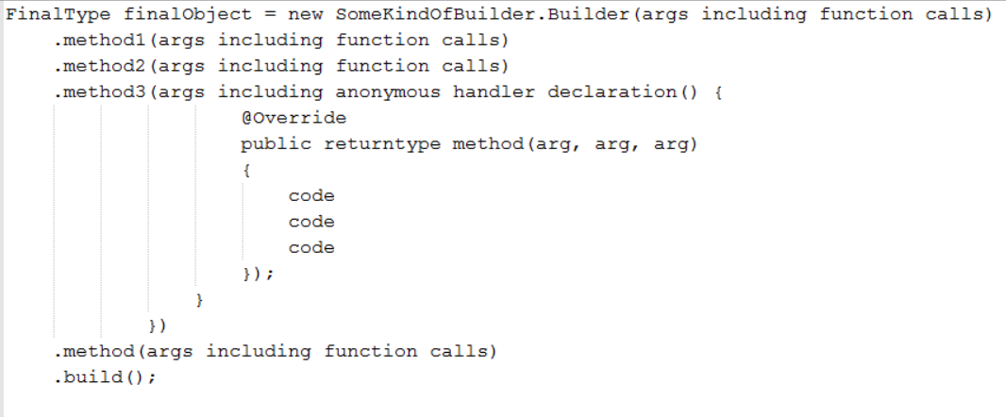
Requirements Note
You will see a lot of examples of using builders where the code looks like this:
Notes:
That is one line of code.
This is a shorthand style which will compile, but is hard to read.
Worse, if you don’t know what each of those method calls actually needs and returns (returning in this construct goes forward to the next method call), you will find it nearly impossible to customise use of the builder later on (i.e. make it do what you want).
Therefore, for this practical, this syntax is not permitted.
One builder method call per line
All intermediate returns must be saved in an explicitly type variable
No in-line anonymous classes may be declared.

Slide 7
Requirements Note
Builder created and stored in a variable of the correct type.
One builder method call per line
All intermediate returns must be saved in an explicitly type variable
No in-line anonymous classes may be declared.

Slide 8
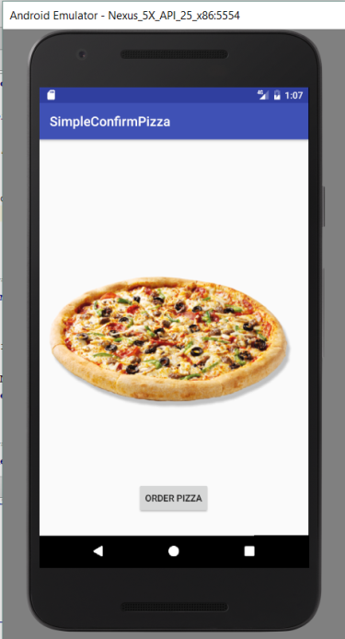
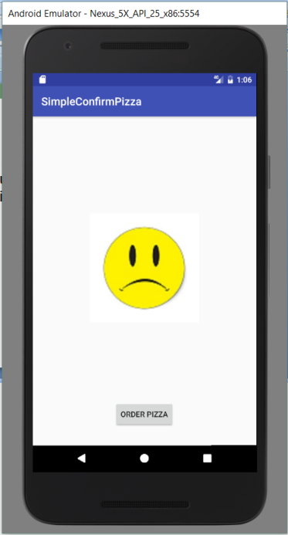
In-Class Task
Build the Confirm Pizza app (see last lecture for details) using an Alert Builder to construct the confirmation dialogue window.
Notes:
Make sure you implement the icon.
Useful images on I drive
Feel free to discuss/work together, but everyone should make their own version and upload it to their own repo for future reference.

Slide 9
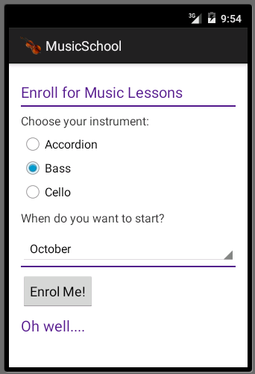
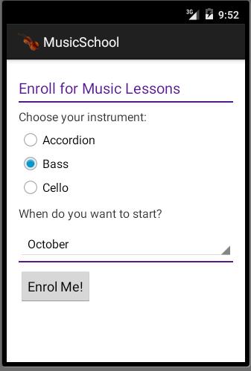
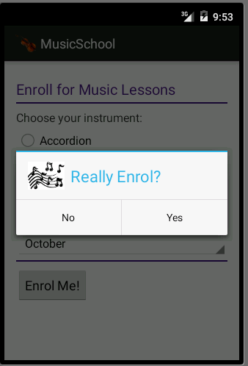
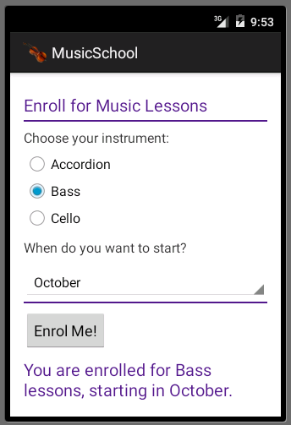
Optional Challenge Task
Add a dialog to your Music Survey application to provide correct confirmation before enrolment.
no
yes
Notes:
Strongly encouraged.
It is always a good exercise to go back to code you’ve written in the past and try to extend it.
This gives you a good indication of whether you wrote your code well initially: if it is a pain to add new functionality, the code wasn’t set up optimally.

